Slide 1
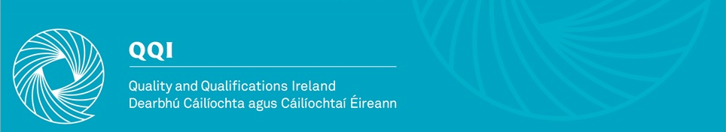
Introduction to the
QQI Quality Assurance Guidelines Website
Ross Woods, QQI

Slide 2

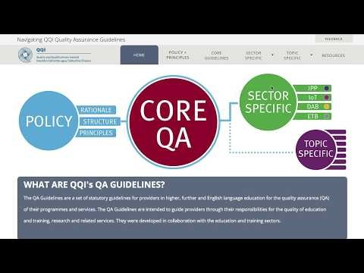
Introduction to Online QA Guidelines

Slide 3
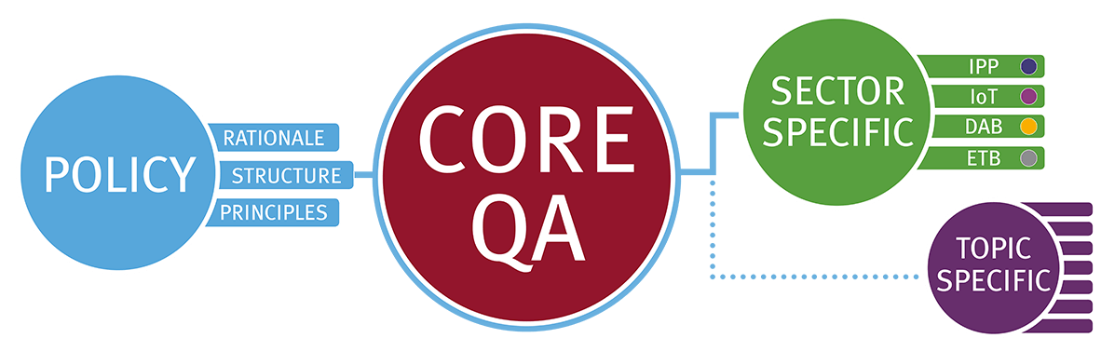
Introduction to Online QA Guidelines
Purpose of website
1. To help give providers a clearer picture of how to use QQI QA Guidelines and Policy;
2. To map out how the different guidelines (Core, Sector-specific, Topic-specific) are connected.

Slide 4
Introduction to Online QA Guidelines
Purpose of website
1. To help give providers a clearer picture of how to use QQI QA Guidelines and Policy;
2. To map out how the different guidelines (Core, Sector-specific, Topic-specific) are connected.

Slide 5
Introduction to Online QA Guidelines
Purpose of website
1. To help give providers a clearer picture of how to use QQI QA Guidelines and Policy;
2. To map out how the different guidelines (Core, Sector-specific, Topic-specific) are connected.

Slide 6

Introduction to Online QA Guidelines
Purpose of website
1. To help give providers a clearer picture of how to use QQI QA Guidelines and Policy;
2. To map out how the different guidelines (Core, Sector-specific, Topic-specific) are connected.

Slide 7
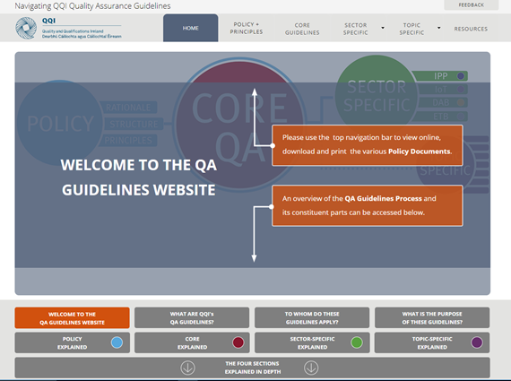
Introduction to Online QA Guidelines
How to use the website
To find out what the guidelines are and how they should be used – click on the grey tabs on the site’s main page

Slide 8
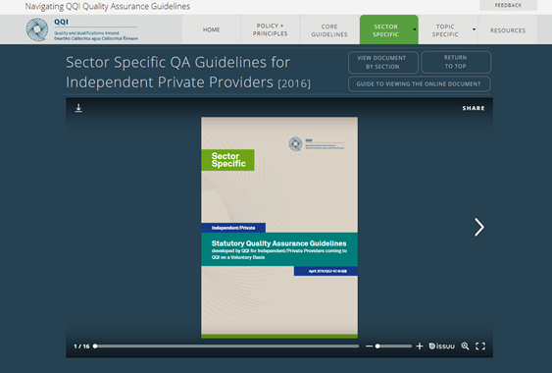
Introduction to Online QA Guidelines
On the website you can…
Browse an entire document, such as the QA Guidelines for Independent/Private Providers

Slide 9
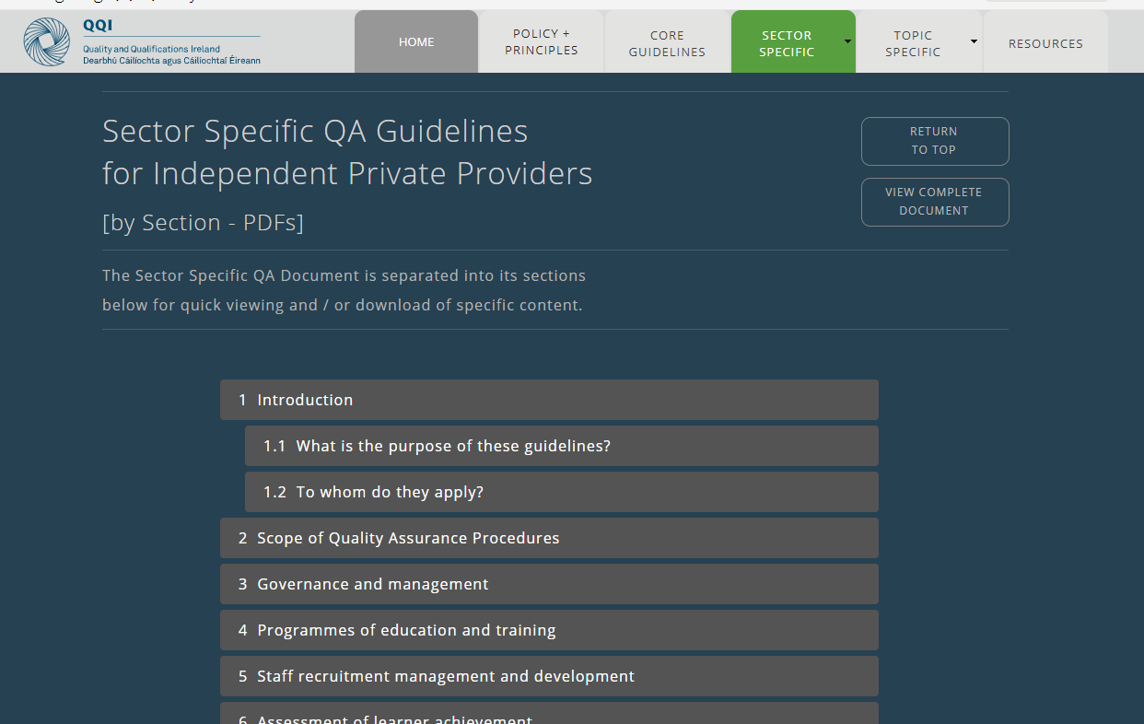
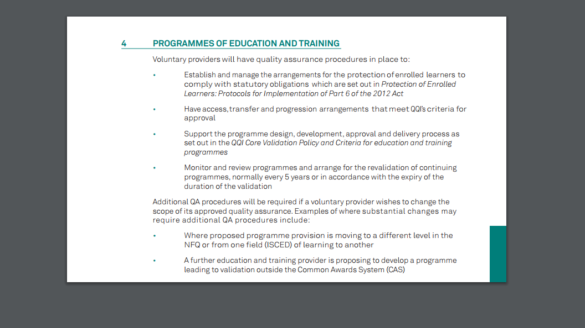
Introduction to Online QA Guidelines
On the website you can…
Or go directly to a particular section and read or print off the ones needed

Slide 10
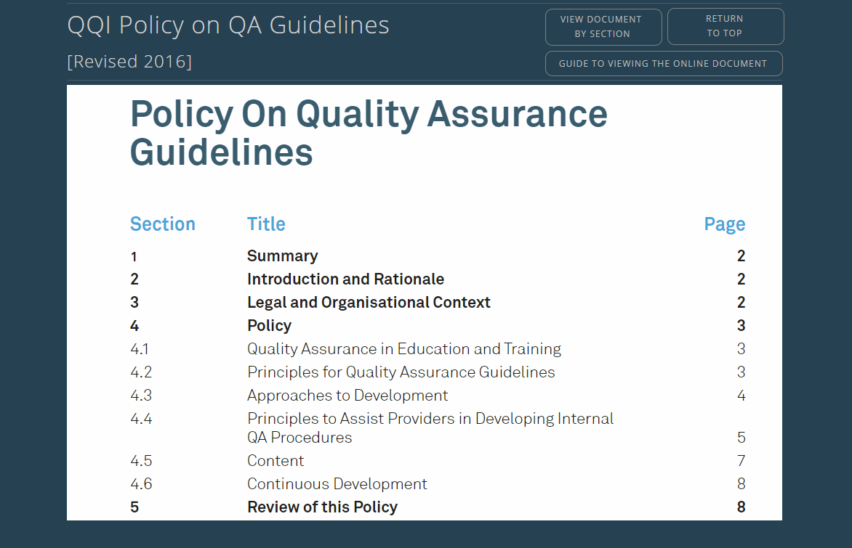
Introduction to Online QA Guidelines
Using the QA Guidelines…
Start with the Policy on Quality Assurance Guidelines

Slide 11


Introduction to Online QA Guidelines
Using the QA Guidelines…
Start with the Policy on Quality Assurance Guidelines

Slide 12
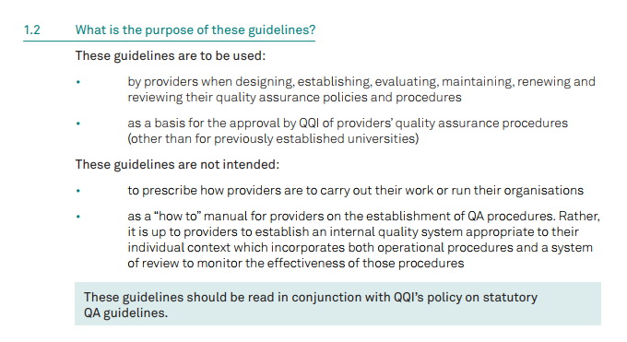
Introduction to Online QA Guidelines
Using the QA Guidelines…
Next move on to the Core Statutory Quality Assurance Guidelines

Slide 13
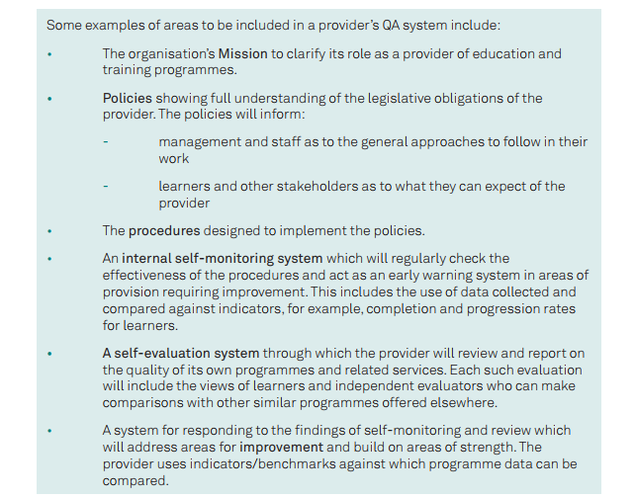
Introduction to Online QA Guidelines

Slide 14
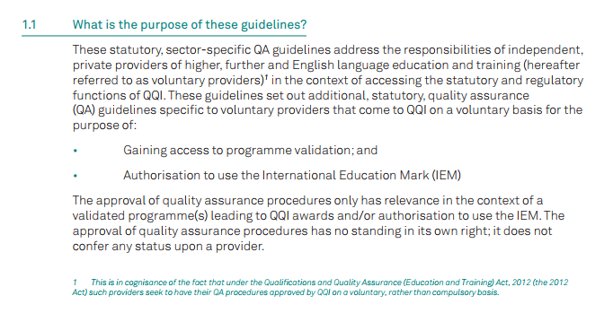
Introduction to Online QA Guidelines
Using the QA Guidelines…
Finally, refer to the Sector-Specific Statutory QA Guidelines for Independent/Private Providers

Slide 15
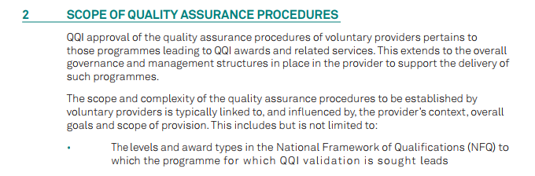
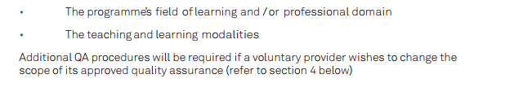
Introduction to Online QA Guidelines
Using the QA Guidelines…
Finally, refer to the Sector-Specific Statutory QA Guidelines for Independent/Private Providers

Slide 16
Introduction to Online QA Guidelines
Useful Links
QQI website
Online QA Guidelines
QA Guidelines (main site)
Initial Access to Programme Validation
Programme Validation

