Slide 1
Identification of Skills Needs in Ireland Institutions, Data, Methods and Use
John McGrath, Labour Market Economist,
Skills and Labour Market Research Unit (SLMRU)
SOLAS (Irish Further Education and Training Authority)
and Expert Group on Future Skills Needs
13-14 June 2016

Slide 2
Outline
Institutional framework for identification of skills needs
National Skills Database
Data analysis and quantitative modelling
Key findings
Linking skills research with policy design

Slide 3
Identification of skill needs: institutional framework
Employment permits
National Skills Council
9 Regional Skills Fora

Slide 4
Institutional framework: Skills and Labour Market Research Unit
Since 2002

Slide 5
Skills and Labour Market Research Unit: National Skills Database
Award 2008
Since 2003
National Skills Database

Slide 6
National Skills Database
Award 2008
Since 2003
Supply
National Skills Database
Demand

Slide 7
Expansion demand: Occupational forecasts
Shift-share analysis
Scale effect
Sector effect
Skill mix effect
Total effect
.
.
.
.
.
.

Slide 8
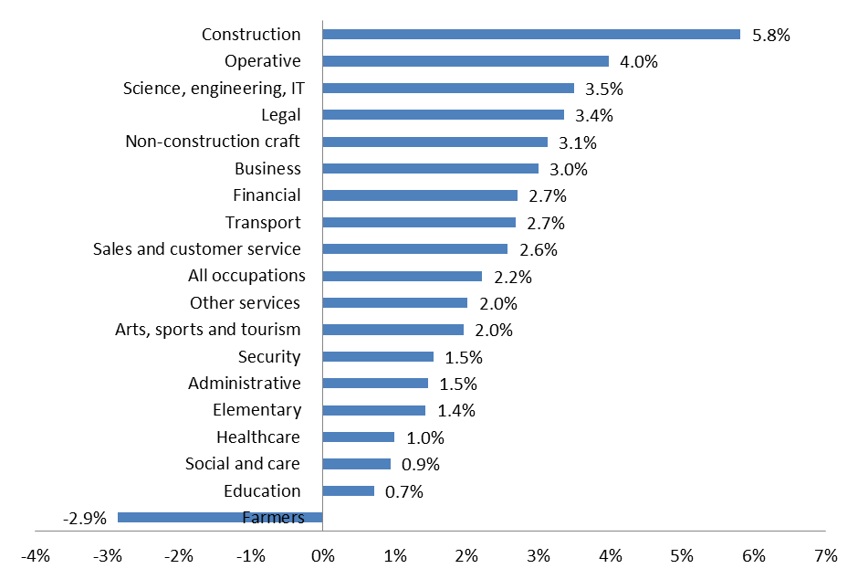
Expansion demand: average annual employment growth by occupational family by 2020

Slide 9
Replacement and churn: labour market transitions
Unemployment
Employment
Inactivity

Slide 10
Labour Market Transitions 2015
Unemployment
81,000
Employment
118,000
Inter-occupational 100,000
Intra-occupational 166,000
144,000
162,000
131,000
148,000
Inactivity
Source: SLMRU analysis of CSO data

Slide 11
Replacement and turnover rates 2015
 |  | Turnover
 | Employment 2014 annual average | Intra-occupational | Intra- occ. and neutral inter-occ. movements
Managers | 150,200 | 4.3% | 6.5%
Professionals | 354,700 | 7.0% | 8.4%
Assoc. profs. | 216,600 | 7.8% | 10.5%
Admin. | 208,500 | 7.2% | 10.8%
Trades | 285,400 | 7.7% | 9.1%
Personal services | 144,600 | 10.0% | 14.6%
Sales | 166,100 | 12.5% | 17.2%
Operatives | 144,900 | 10.2% | 13.3%
Elementary | 210,100 | 11.7% | 18.6%
Total | 1,881,200 | 8.4% | 13.0%
Source: SLMRU analysis of CSO data

Slide 12
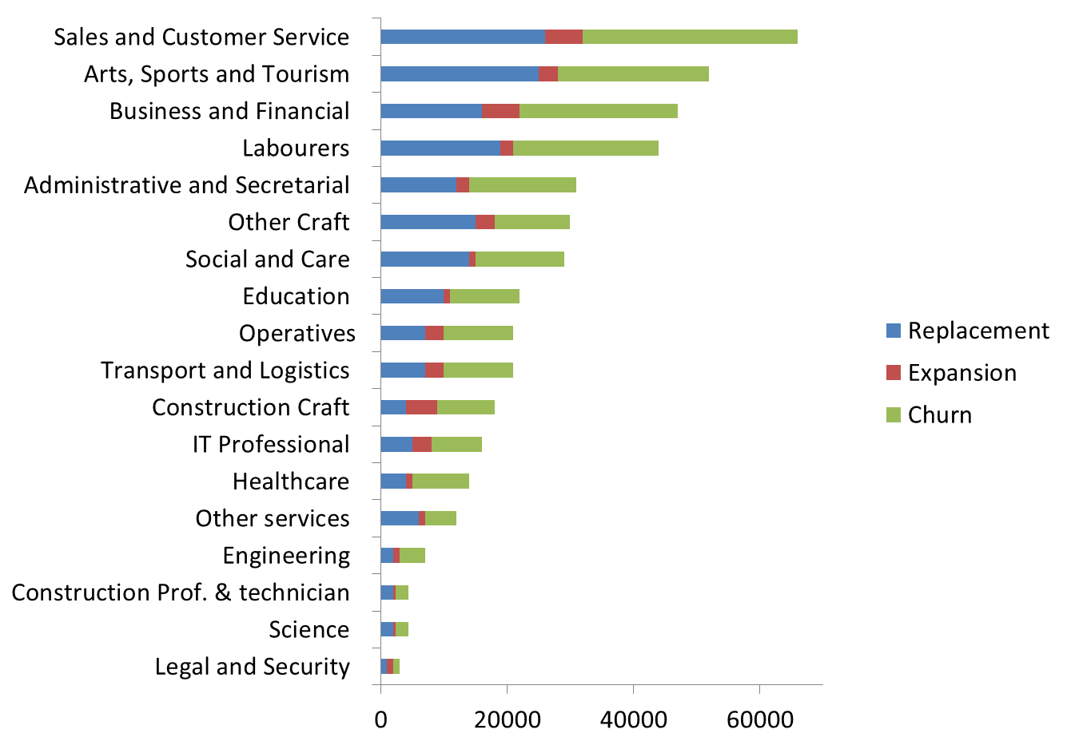
Demand components and churn
Source: SLMRU

Slide 13
Linking research with policy
>
<
+
+
Replacement demand
Expansion demand
Shortage
Surplus
Graduate supply
Job seekers

Slide 14
Linking research with policy

Slide 15
Current demand: difficult to fill vacancies
Professionals/associate professionals (ICT, engineering, science, finance, health)
Clerical (multilingual credit control/debt control and supply chain)
Skilled trades (chefs, tool making, welding, butchers)
Sales (technical sales, multilingual customer support, online sales and marketing)
Operatives (CNC, drivers (fork lift and special vehicle))
Retention issues (care, chefs, butchers, elementary (e.g. waiters))

Slide 16
Policy use
Education and training provision (course portfolio)
Immigration (list of eligible and ineligible occupations)
Labour market activation
Career guidance
Enterprise development

Slide 17
Contact details
Jasmina Behan
Senior Research Officer,
SOLAS and Expert Group on Future Skills Needs
Tel. ++ 353 1 533 24 59
Relevant reports:
National Skills Bulletin 2015
Monitoring Ireland’s Skills Supply 2015
Occupational Employment Projections 2020
Regional Labour Markets Bulletin 2015
Vacancy Overview 2015
www.skillsireland.ie
www.solas.ie

