Slide 1
The EQAVET Framework – supporting quality and relevance of VET
Arancha Oviedo, EQAVET Secretariat
Dublin, IQAVET Conference
8 March 2017

Slide 2
Added-value of EQAVET
EQAVET helped to improve the implementation of QA in EU countries; and served as a catalyst for reform
The choice of the Recommendation as legal basis was a good one; the work at European level as well as in MS has speeded up since the adoption of the Recommendation
The material developed at European level is felt to be user friendly and useful but difficult to disseminate at national level because of need of adaptation
NRPs, key role – need to be appropriately resourced
EQAVET is consistent and complementary to the other tools (ECVET, EQF) but does not cover certain aspects dealt with by ECVET and EQF (e.g. qualification design, certification process)

Slide 3
Challenges faced by Member States
Evolving labour market
Social context for VET
Migration
Skills obsolescence and mismatch
System-driven approaches
New forms of learning and course delivery

Slide 4
EU cooperation in VET
Copenhagen Process
Bruges Communiqué 2010 and its short term deliverables 2010-20
Riga Conclusions 2015 reduced set of sort term deliverables for 2015-20
New Skills Agenda June 2016 –focus on employability

Slide 5
Why quality assurance of VET?
Increase transparency & mobility
European cooperation in VET
More efficient VET, adapted to the labour market
Mutual learning and consensus building
Tools to support QA at national/regional levels
Common principles, reference criteria and instruments
Education and Training policy context
More attractive VET in the continuum of LLL and progression pathways
More effective and better VET
Responsiveness to societal needs and social inclusion

Slide 6
The EQAVET Framework – QA management tool
Designed to promote better VET
A reference instrument to help authorities of MS and providers to evaluate and improve; and promote and monitor the improvement of their VET systems
Uses QA as a systematic approach to modernising education systems, especially by improving the effectiveness of training
MS and providers are invited to develop/use this instrument on a voluntary basis.
Main users are national/regional authorities, VET providers, public /private bodies responsible for ensuring and improving the quality of VET
Complements the work of EQF and ECVET

Slide 7
Short term deliverables for VET
Bruges Communiqué and short term deliverables 2010-2015 related to EQAVET | Riga Conclusions and short term deliverables 2015-2020
Participating countries were invited to establish at national level a: QA frameworks in accordance with the EQAVET Recommendation by 2013; Common QA framework for VET providers compatible with the EQAVET framework which also applies to WBL by 2015 | Promote WBL in all its forms Further develop QA mechanisms in VET in line with the EQAVET, and establish continuous information and feedback loops in IVET and CVET based on LO Enhance access to VET and qualifications for all through more flexible and permeable systems Further strengthen key competences in VET curricula Introduce systematic approaches and opportunities for initial and continuous professional development of VET teachers, trainers and mentors in both school and WBL settings

Slide 8
EQAVET indicators used at system level for the IVET and CVET sectors

Slide 9
A culture of QA shared by all stakeholders
Underpinning an evidence-based and outcomes focused approach to QA in VET
Support continued improvement
VET adheres to principles of access and equity and maximizes outcomes
Respond to the need of the labour market and society

Slide 10
EQAVET work in key areas
EQAVET Indicators – improving the labour market relevance of VET systems
PLAs and Policy briefs on EQAVET indicator 5, 6, 9 and 2
Supporting an evaluation and quality improvement culture
PLAs and Policy brief on Self-evaluation for VET providers; the impact of QA systems in IVET systems; and on Early warning system, averting drop-outs, supporting providers to implement improvement
VET in employment –supporting QA in WBL and CVET
- Symposium on learning from sectoral approach to QA of VET
- Building blocks on quality assuring WBL
- Supporting AL, CVET and soft skills development by using quality assurance descriptors and indicators
Support to National Reference Points and EQAVET Forum as part of EU VET week
Activities to support VET providers identify key features of their own approach to QA through self-reflection; utilising the EQAVET IT tool for systems and providers (case studies and a glossary of terms)
Increase visibility
Supporting learning outcomes – a partnership approach
-Information Gathering Exercise on QA procedures in the processes of certification, curricula setting, accreditation and training of trainers
-Using ECVET and EQAVET principles: some early experiences at national level
- Joint activities EQAVET, ECVET, EQF; and with HE

Slide 11
Work on Complementing EQAVET, work in 2017 and beyond
Apprenticeship/work-based learning provision and in-company training;
the processes of defining, describing and assessing learning outcomes;
qualification design, assessment and certification;
the pedagogical processes associated with learning outcomes;
the teachers’ and trainers’ role in the quality assurance process;
procedures which are used in the validation of non-formal and informal learning in line with EQF/NQFs;
planning and improving the review phase of the quality assurance cycle.

Slide 12
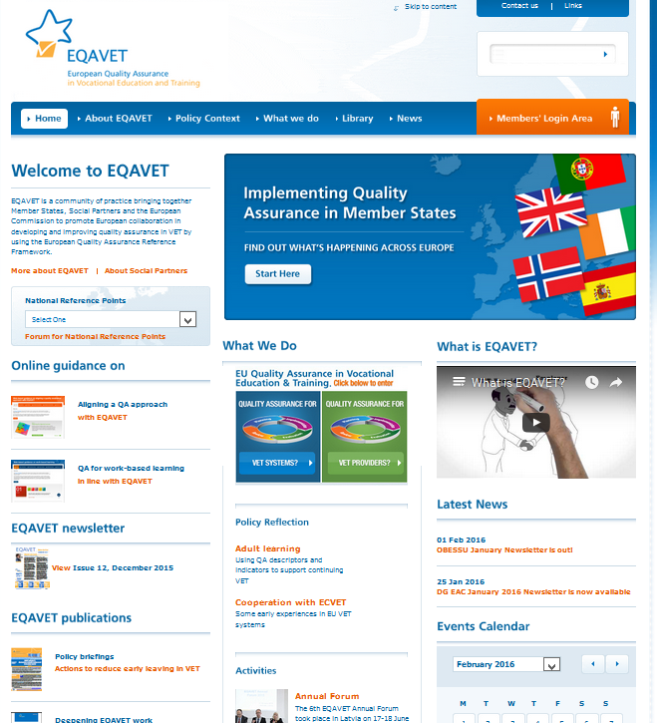
www.eqavet.eu

Slide 13
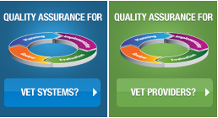
Guidelines to support VET systems and providers

Slide 14
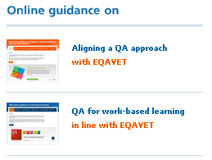
Guidelines to support VET systems and providers

Slide 15
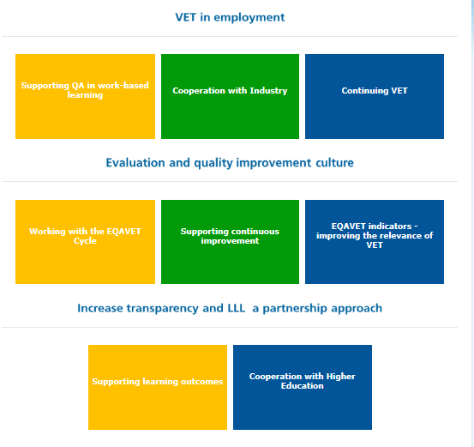
EQAVET Resources

Slide 16
Thank you!
www.eqavet.eu

