Slide 1
Quality management in VET: using the quality cycle and indicators to improve VET provision
Dublin, 8 March 2017
Maria Emília Galvão
meg.bfg@gmail.com

Slide 2
Objective: to contribute to the ongoing reflection on quality management in VET
1. By way of introduction
A few wise words…
The 5Cs in evaluation capacity building
Revisiting key concepts in VET quality management
2. The art and science of designing a self- monitoring system
The self- monitoring cycle and the use of EQAVET indicators
The EQAVET indicators
3. Questions for group discussion…

Slide 3
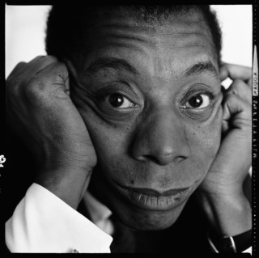
First, a few wise words …
“Not everything that is faced can be changed,
but nothing can be changed until it is faced.”
James Baldwin, American author (1924-1987)
Source: Photography by Richard Avedon / © The Richard Avedon Foundation

Slide 4
Then, a working definition…
A theory of change for VET improvement can be as simple as the following:
If we conduct A activities, to produce B outputs, in C contexts, then we will produce D outcomes, which will ultimately contribute to E impacts
ACTIVITIES
OUTPUTS
CONTEXTS
OUTCOMES
IMPACT

Slide 5
The 5 Cs in evaluation capacity building (ECB)
5Cs in ECB
CURIOSI-
TY
COMMU-NICATION
COMMIT-
MENT
CONNEC-
TION
COURAGE
Source: Danseco, E.(2013). The five Cs for innovating in evaluation capacity : lessons from the field. The Canadian Journal of Program Evaluation Vol. 28 No. 2 Pages 107–117 ISSN 0834-1516 Copyright © 2013 Canadian Evaluation Society.

Slide 6
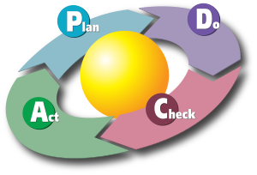
Key concepts in VET quality management: the PDCA Cycle & feedback loops (1)
Feedback occurs when outputs of a system are routed back as inputs as part of a chain of cause-and-effect that forms a circuit or loop
PLAN: Design or revise VET process components to improve results
DO: Implement the plan and measure its performance
CHECK: Assess the measurements and report the results to stakeholders
ACT: Decide on changes needed to improve the process

Slide 7
Key concepts in VET quality management: indicators and the DIKW pyramid (2)
Indicator: […] An indicator is a quantitative or qualitative variable that provides a simple and reliable basis for assessing achievement, change or performance.
Source: UN(2002). Handbook on monitoring and evaluating for results http://web.undp.org/evaluation/documents/handbook/me-handbook.pdf
Data: symbols that represent the properties of objects and events."
Information: answers to questions that begin with such words as who, what, when, where, and how many
Knowledge: answers to how-to questions
Wisdom: the ability to increase effectiveness
Source: Ackoff, R. L. (1999) Ackoff’s Best. New York: John Wiley & Sons, pp 170 – 172 http://faculty.ung.edu/kmelton/Documents/DataWisdom.pdf

Slide 8
The DIKW pyramid
Data
symbols that represent the properties of objects and events
Information
answers to questions that begin with such words as who, what, when, where, and how many
Knowledge
answers to how-to questions
Wisdom
ability
to increase
effectiveness
Decision making: know what to do, act or carry out
Synthetising
Analysing
Collecting
Source: Ackoff, R. L. (1999). Ackoff’s Best. New York: John Wiley & Sons, pp 170 – 172
http://faculty.ung.edu/kmelton/Documents/DataWisdom.pdf

Slide 9
Key concepts in VET quality management (3)
“Dos”: Indicators and data help
Measure learners progress and ensure they don’t drop out
Measure programme effectiveness & assess instructional effectiveness
Guide curriculum development
Allocate resources wisely
Promote accountability by reporting to the relevant stakeholders
Maintain education and training focus
Show trends (not necessarily solutions…)
“Don’ts”: Indicators and data do not help, if…
The data are not valid and reliable
Appropriate questions are not asked after reviewing the data
Data analysis is not used for making wise decisions

Slide 10
The 10 EQAVET indicators
Indicator no. 1 Relevance of quality assurance systems for VET providers
Indicator no. 2 Investment in training of teachers and trainers
Indicator no. 3 Participation rate in VET programes
Indicator no. 4 Completion rate in VET programmes
Indicator no. 5 Placement rate in VET programmes
Indicator no. 6 Utilisation of acquired skills at the workplace
Indicator no. 7 Unemployment rate
Indicator no. 8 Prevalence of vulnerable groups
Indicator no. 9 Mechanisms to identify training needs in the labour market
Indicator no. 10 Schemes used to promote better access to VET

Slide 11
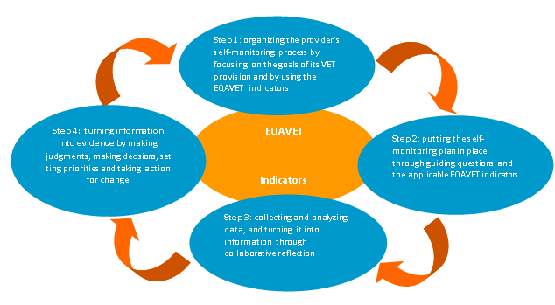
The self-monitoring cycle and the use of EQAVET indicators

Slide 12
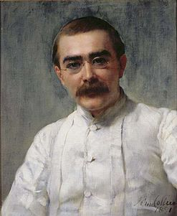
Other wise words…
I keep six honest serving-men (They taught me all I knew); Their names are What and Why and When And How and Where and Who
Rudyard Kipling, English author (1865-1936)
A portrait of Kipling by John Collier ca. 1891.
https://en.wikipedia.org/wiki/Rudyard_Kipling

Slide 13
A few questions for discussion…
Group discussion(1)
What goals has your organization set for the next (three-five) years?
What indicators and data are relevant for your organization and its goals and why?
How will your organization collect, analyse and use data to improve provision over time?
Who will be involved in indicator selection, data collection and analysis?

Slide 14
A few questions for discussion (cont.)
Group discusion (2)
Which indicators are more relevant nationally and why?
Which is the most important indicator nationally right now?
What three points will each group make to plenary?

